Slide 1
REDI Deep Dives: Cultivating Upstanders

Slide 2
Welcome
Thank you for your interest in engaging with this REDI resource.​
If you decide to use this resource, could you please fill out this form?​
(https://redi.med.ubc.ca/resourcefeedback)
Let us know what unit at UBC you are from and any feedback you may have. This will help us understand how our resources are being used and ensure that we are meeting the needs of the community. ​
If there are other similar types resources you would like to see, please let us know in the form, too. ​
Thanks, ​
REDI Team

Slide 3
The Bystander Effect
Bystander Effect or Bystander Apathy- A phenomenon in which the presence of other people discourages individuals from intervening in an emergency, against a bully, during an assault, or when some other injustice is being committed. The greater the number of bystanders present in the situation, the less likely that any one of them will provide help to a person in distress, as each individual feels like they bear less responsibility for intervening.
In working to bring about equity, diversity, and inclusion, it is important to recognize the bystander effect as a barrier that can prevent otherwise kind and caring people from intervening when they witness an act of discrimination.
In the workplace and learning environment, the bystander effect contributes to creating an unsupportive environment for people who are members of historically marginalized groups. In the face of subtly or blatantly discriminatory events, actions, or policies, a lack of response pushing back against discrimination sends a message that the workplace/learning environment condones discrimination.
In this way, choosing inaction by being a bystander is equivalent to condoning discrimination, which creates an emotionally stressful workplace and learning experience.
Instead of being bystanders, the REDI team encourages people to become “Upstanders,” people who have the skills and courage to intervene when they witness injustice. While it may not be possible to prevent all people from saying discriminatory things, if colleagues, students, instructors can become better upstanders, this can help to reduce the emotional distress because they can feel like “that person was racist but my unit, my colleagues, my students, my institutions support me.”

Slide 4
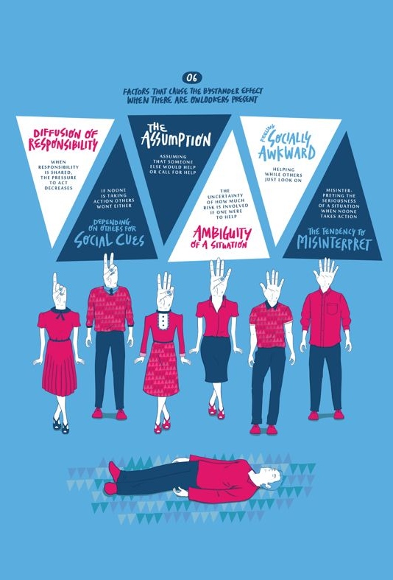
Six Factors That Cause the Bystander Effect When Others Are Present
Diffusion of Responsibility- When responsibility is shared, the pressure to act decreases
Depending On Others for Social Cues- If no one is taking action, others will not either.
The Assumption- Assuming someone else will help or call for help.
Ambiguity of a Situation- The uncertainty of how much risk is involved if no one were to help.
Feeling Socially Awkward- We worry that we will feel awkward if we help while others just look on
The Tendency to Misinterpret- Misinterpreting the seriousness of a situation when no one takes action.
This Photo by Unknown author is licensed under CC BY-SA.

Slide 5
Examples
A middle-aged person collapses in public, but nobody calls 911
An attending physician makes an offensive joke about a sedated patient in front of residents, but nobody speaks up.
Someone screams for help in a crowd, but you assume someone else in the crowd will intervene
You feel that a workplace policy is unfairly discriminatory, but you assume it is someone else's responsibility to point it out. You think to yourself, what do you know about equity anyways, you are just a white guy.
You are in a team meeting and your boss berates, belittles and unfairly undermines a racialized woman who is leading a particular initiative. No one in your unit does or says anything.

Slide 6
Session instructions
The facilitator might want to read over the resources on the Right to Be website (or the other additional resources that REDI uses)
https://righttobe.org/guides/bystander-intervention-training/
This session is structured as follows:
Short introduction about the bystander effect and EDI (using the slides here)
Small group discussion questions about the bystander effect
Small group discussion about the 5 D's
Practice in small groups using realistic scenarios

Slide 7
Paired or small group discussion
Ensuring that you are respecting confidentiality, share stories of the types of situations when you were either a bystander or you witnessed the bystander effect.
Have you ever intervened in a situation (medical or otherwise) because nobody else was acting? How did you feel?

Slide 8
Counteracting the Bystander Effect- The 5Ds
Be an "Upstander," not a bystander. -
When an upstander sees a problem or injustice, they choose to do at least one of the following...
Delegate- Get help from someone else. Give tasks to other witnesses. Find a person in authority to intervene.
Distract- Neutralize tension by interrupting before things escalate. Shift the focus away from the situation. Go to the person being targeted. Speak directly to them or help them leave the situation.
Delay-If it is not safe to intervene in the moment, you can follow-up once things have deescalated by talking to the person being targeted.
Document- Where immediate intervention is not possible or safe you can document and report the experience
Directly Intervene- After assessing the situation and your own capacity and safety you may choose to directly intervene by challenging the situation or conduct directly.
You may want to watch some examples of these techniques here (More examples are in the notes for this slide)
https://www.youtube.com/watch?v=mt7X5tjp9Js
https://www.youtube.com/watch?v=t21vwD5eHJc
Notes:
https://www.youtube.com/watch?v=ASkX2O9zB24 - each D has a video
https://www.youtube.com/watch?v=7JUzzBmbchs on a train- direct intervention
https://www.youtube.com/watch?v=4hg0CoFIuGY college campus, 5 D's Whittier College
https://www.youtube.com/watch?v=t21vwD5eHJc UEA wellbeing 5 D's, context neutral
https://www.youtube.com/watch?v=m1ABrJMo0RA Silly, fun take
https://www.youtube.com/watch?v=DCApwX-X5P0 Stanford Surgery PD about Upstander Engagement, specific to patients
https://www.youtube.com/watch?v=0mPJf40unEk student focused, mix of humor and serious
https://www.youtube.com/watch?v=UIfy62dhpBI Monash uni, public example, oddly dramatized
https://www.youtube.com/watch?v=-T6EIqUsszA PSA version – animated, anti-Asian-specific
https://www.youtube.com/watch?v=ZADfaf5RzNk University of Iowa

Slide 9
Practice: Scenario
Scenario: You are discussing the new group of medical students with a colleague in the hallway. Your colleague is White and is working with several students from racialized backgrounds during this rotation.
Offhandedly, your colleague remarks to you, "It boggles my mind how these people just seem to get more incompetent each year."
Your colleague was not aware, but one of the students was walking down the hallway and clearly overheard the comment.
Below are some examples of how you could use the 5D strategies to be an upstander in this scenario.
Delegate: You could go to a department leader or supervisor, mention the offensive comment, and ask them to take action.
Distract: You could break off the conversation with your colleague, greet the student, and begin walking with them and discussing a totally different subject.
Delay: You could find the student at a later, more appropriate time, and address the comment with them, saying something such as, "Hey, are you feeling all right after that comment?"
Document: You could make a note on your phone about the date and time and what your colleague said in the presence of a student, in case it could be important to have in the future.
Directly Intervene: You could say something in the moment to your colleague, such as "I don't understand what you mean by 'these people,' could you explain what you mean by that?"

Slide 10
Paired or small group discussion
The key to learning how to become an upstander is to come up with an action plan and to ensure that you do something. Depending on the power you hold, your relationships and your own sense of personal safety, you may feel differently able to be direct or even distract. Develop your own style and discuss - in what types of contexts will you use which "D" of the 5 D's?

Slide 11
Application: Scenario
[Feel free to modify the narrative below to better fit your specific context]
You are observing your colleague, Dr. Patel, who is supervising a group of medical students, including Mike, who uses a wheelchair.
Dr. Patel sees Mike for the first time in class, and from his private remarks to you, it is clear that he assumes that his use of a wheelchair will limit Mike's ability to perform their duties as a medical student.
During a break in class, while other students are present, Dr. Patel asks Mike about the challenges he may experience in practice. Mike explains that he has been successful in his academic career thus far, and he suggests that he and Dr. Patel meet after class regarding accommodations.
The rest of the students are visibly uncomfortable, but aside from Mike, nobody else replies to Dr. Patel.
[activity on next slide]

Slide 12
Debrief
As a witness to the situation described on the previous slide, how might you be an upstander, rather than contributing to the bystander effect?
Brainstorm some potential actions in the following categories:
Delegate-
Distract-
Delay-
Document-
Directly Intervene-
How could the situation have been approached more effectively?

